Slide 1
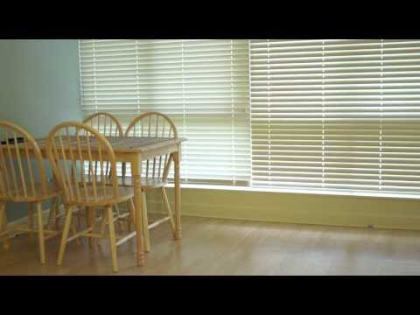

Slide 2
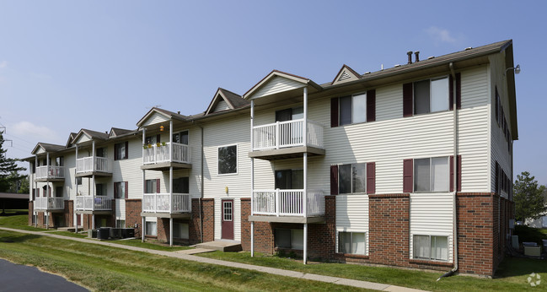
Finding Apartments: Understanding Apartment Ads

Slide 3
Warm up Discussion
Work in pairs to answer the following questions:
a) How did you find your current apartment?
b) How do people find apartments in the US?
c) What apartment features are important to consider when you are looking an apartment?

Slide 4
Finding Apartments
Information: Apartment websites, apartment flyers, friends, apartment ads, apartment agencies
Consider: Cost, Amenities, appliances, utilities, location, security
*It is important to understand the language used to describe apartments
Notes:
Tell students that it is important to understand the language used to describe apartments so: you can describe the features you want, and to be able to understand what apartment adverts say about the apartment

Slide 5
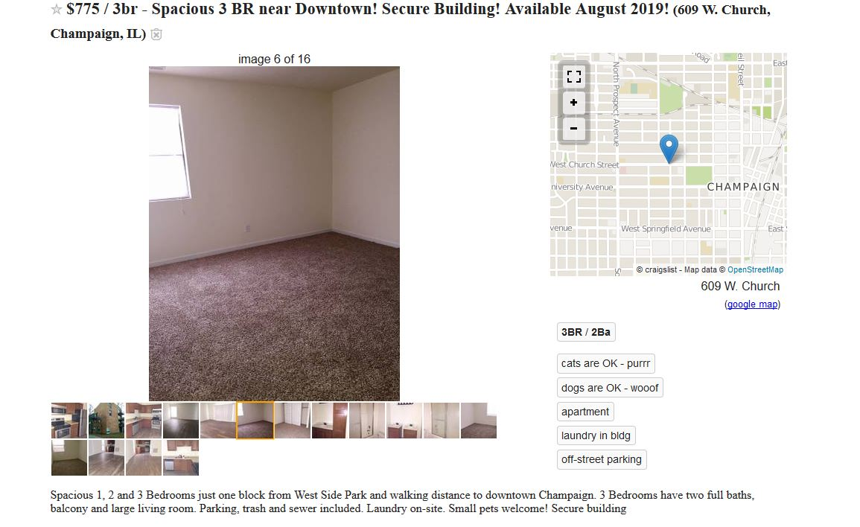

Slide 6
Apartment Vocabulary
Instructions: In your pairs, write a word that best describes each of the pictures. Use words from the list provided.
Handout 1

Slide 7
Amenities and Appliances
Amenities - additional features of the apartment e.g. parking
Appliance - any machine used at home e.g. stove

Slide 8
Amenities and Appliances
Instructions: Now work in pairs to answer the questions on the handout
Handout 2

Slide 9
Utilities
Utilities - public services e.g. electricity
What other public services do you get at your apartment?

Slide 10
Utilities
Discussion question: Some utilities are usually included in rent. If some utilities are not included in rent, then you have to pay for them separately. Which of the following utilities are included in your rent?
Electricity, Heating, Cooking gas, Garbage collection, Water, Internet, Cable TV

Slide 11
Short forms used in apartment adverts
Instructions: Work in pairs to match the short forms with their meaning.
Handout 3

Slide 12
Apartment Features Discussion
Instructions: Discuss the following questions in pairs:
a) What features of your apartment do you like?
b) What features of your apartment don’t you like?
c) Describe the kind of apartment you would like to move to – if that were possible.

Slide 13
Apartment Advertisements
Instructions: Use information from the 3 adverts to answer the questions on the your handouts.
Handout 4 & ads

Slide 14
Review: Describing Apartments
· The size of the apartment
· The utilities included/not included
· Amenities and appliances

Slide 15
Dialogue about apartments
Instructions: In this activity you will pretend to be two friends talking about apartments. In your conversation, be sure to describe:
· The size of the apartment
· The utilities included/not included
· Amenities and appliances
Notes:
Handout 5

Slide 16
Review
Examples of:
Amenities
Utilities
Appliances

